Slide 1
Javascript Practicals
3.3
Functions

Slide 2
Task 3.3.1
Create a function that is able to return a specific percentage of any number.
For example you want to know what 30% of 135 is.
Percentage Calculator

Slide 3
Task 3.3.1
Create a function named percentageCalculator
Add 2 arguments for “number” and “percentage”
Do the maths required to work out a percentage with the arguments
Return the result of the maths
Console.log the returned value
Percentage Calculator
Notes:
Luke Codepen for reference : https://codepen.io/pixel_to_code/pen/WNwyJVm

Slide 4
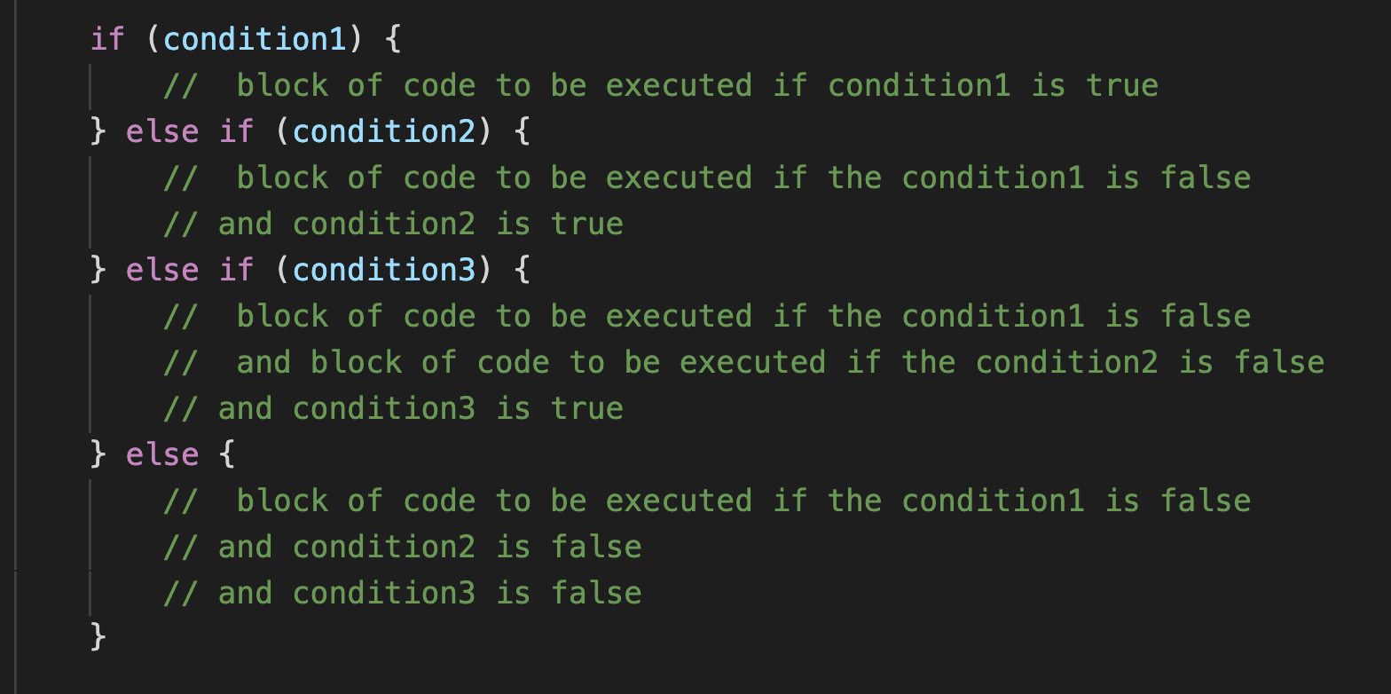
IF ELSEIF ELSE Statements
IF ELSEIF ELSE statements execute logic in the order they are provided, if none of the logical conditions are met the ELSE statement at the end is executed.
You can choose to exclude the ELSE statement if you don’t require a default output.

Slide 5
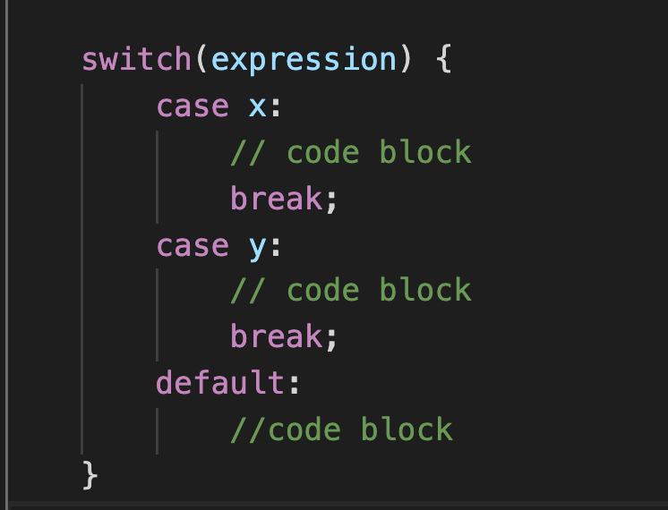
Switch Statements
Switch statements in Javascript are similar to IF statements.
Switch statements can be declared to cover a number of different outcomes (cases) on a given variable.
IF ELSE statements can also be used to have logic that doesn’t apply to the same variable where as switch statements are the values of the same logic.
If you are always going to be providing an output based on the same input then switch statements are simpler to read and write than IF ELSE.

Slide 6
Task 3.3.2
Customers can order 3 different types of drink and also select 3 sizes.
Cola, Lemonade and Orangeade
Small, Medium and Large
The button they press have the values “cola”,”lemon”,”orange”
Create a function that will output the message “You have ordered a {size} of {softDrinkLabel}”
Switch Statement

Slide 7
Task 3.3.2
Create a function named drinkOrder
Add 2 arguments for “size” and “drink”
Use a switch statement to determine where the functional code needs to be written
Create a message in each case statement to be returned.
Console.log the returned message
Switch Statement
Notes:
Luke Codepen for reference : https://codepen.io/pixel_to_code/pen/VwaddZM

Slide 8
Task 3.3.3
We need to create a function capable of using the addition, subtraction, multiply, divider or modulus operator on 2 numbers provided.
Calculator

Slide 9
Task 3.3.3
Create a function named calculator
Add 3 arguments for “number1”, “number2” and “operator”
Use a switch statement to determine which operator to use
Add the math code for each operator in the case statement to return the value
Console.log a message “{number1} {operator} {number2} = {value}”
Calculator
Notes:
Luke Codepen for reference : https://codepen.io/pixel_to_code/pen/MWyBYQx

